Slide 1

DOODLE JUMP USING DBMS & JAVASCRIPT TITLE:DODDLE JUMP
SUBMITTED TO:
Ms. Jayati Bharadwaj
Mr. Amit Saxena
SUBMITTED BY:
Yash Bhatnagar(2000820100156)
Saniya Malik(2000820100122)
Shubhangi Rawat(2000820100133)
Satyam Singhal(2000820100125)

Slide 2
TEAM MEMBERS AND THEIR ROLES
Yash Bhatnagar - Front-end(HTML,CSS,JavaScript)
Saniya Malik - Front-end(JavaScript) + DBMS
Satyam Singhal - Back-end(DBMS)
Shubhangi Rawat - Back-end(DBMS)

Slide 3
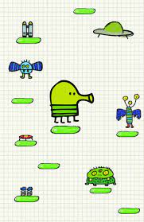
ABOUT DOODLE JUMP
Doodle Jump is a platformed video game developed and published by American studio Lima Sky. Doodle Jump was renowned for its selling rate by App Store standards
In Doodle Jump, the aim is to guide a four-legged creature called "The Doodler" up a never-ending series of platforms without falling.
The left side of the playing field is connected with the right side.
The player can choose to move right or left or to stay.

Slide 4
TECH STACK USED:
FRONTEND:
BACKEND:
Mongodb is a document-oriented NoSQL database used for high volume data storage
HTML to create the document structure and content
CSS to control is visual aspect
JavaScript for interactivity

Slide 5
PERCENTAGE OF TECH USED

Slide 6
ADVANTAGES
Technical
Logical
Minimal hardware requirements, if the system can run the browser then the user can run the game without any problem.
This game is purely customizable on the basis & demand of user.
As this is a web-game there is no need of any installation or any storage.
Unlike the other games when we refresh the site all the data (leader-board) disappear but in it the data remains as it is because we fetch it from database.
It improves the power of concentration of human mind.
It improves strategy and leadership qualities in oneself.
It stimulate creativity , focus & visual memory.
It also helps to reduce stress.

Slide 7
FUTURE SCOPE
Customization at the user’s end for making its experience more fascinating.
We can use this game in future to earn money.
On popular websites like CUT-THE-ROPE with the help of different AD campaign we can even advertise and can make money.

Slide 8
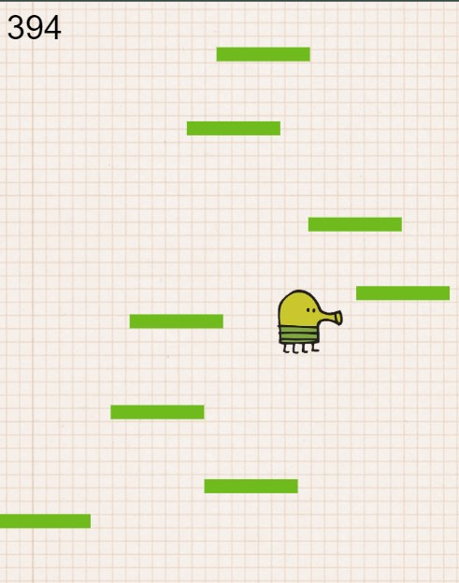
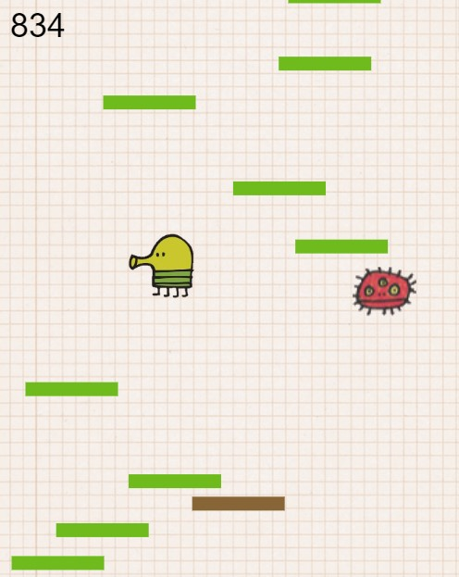
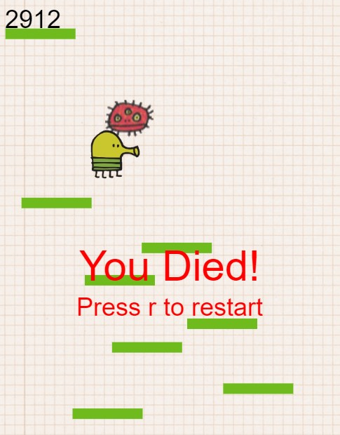
GAME SENSE
1
2
Use AD or Left Right Arrow keys to control the Doodle.
If you touch the monster, the game is over.
Press r to restart the game

Slide 9
CONCLUSION
We modified the game with database and modern JS technologies.
To get amazing features like:
leaderboard,
user customization
Also, if we can build the game to the level of your assumptions, we can use it in a commercial way to earn passive money.

Slide 10
BIBLIOGRAPHY
https://www.cisco.com/
https://codepen.io/
https://www.w3schools.com
https://developer.mozilla.org/en-US/docs
https://www.mongodb.com/

Slide 11


